Slide 1
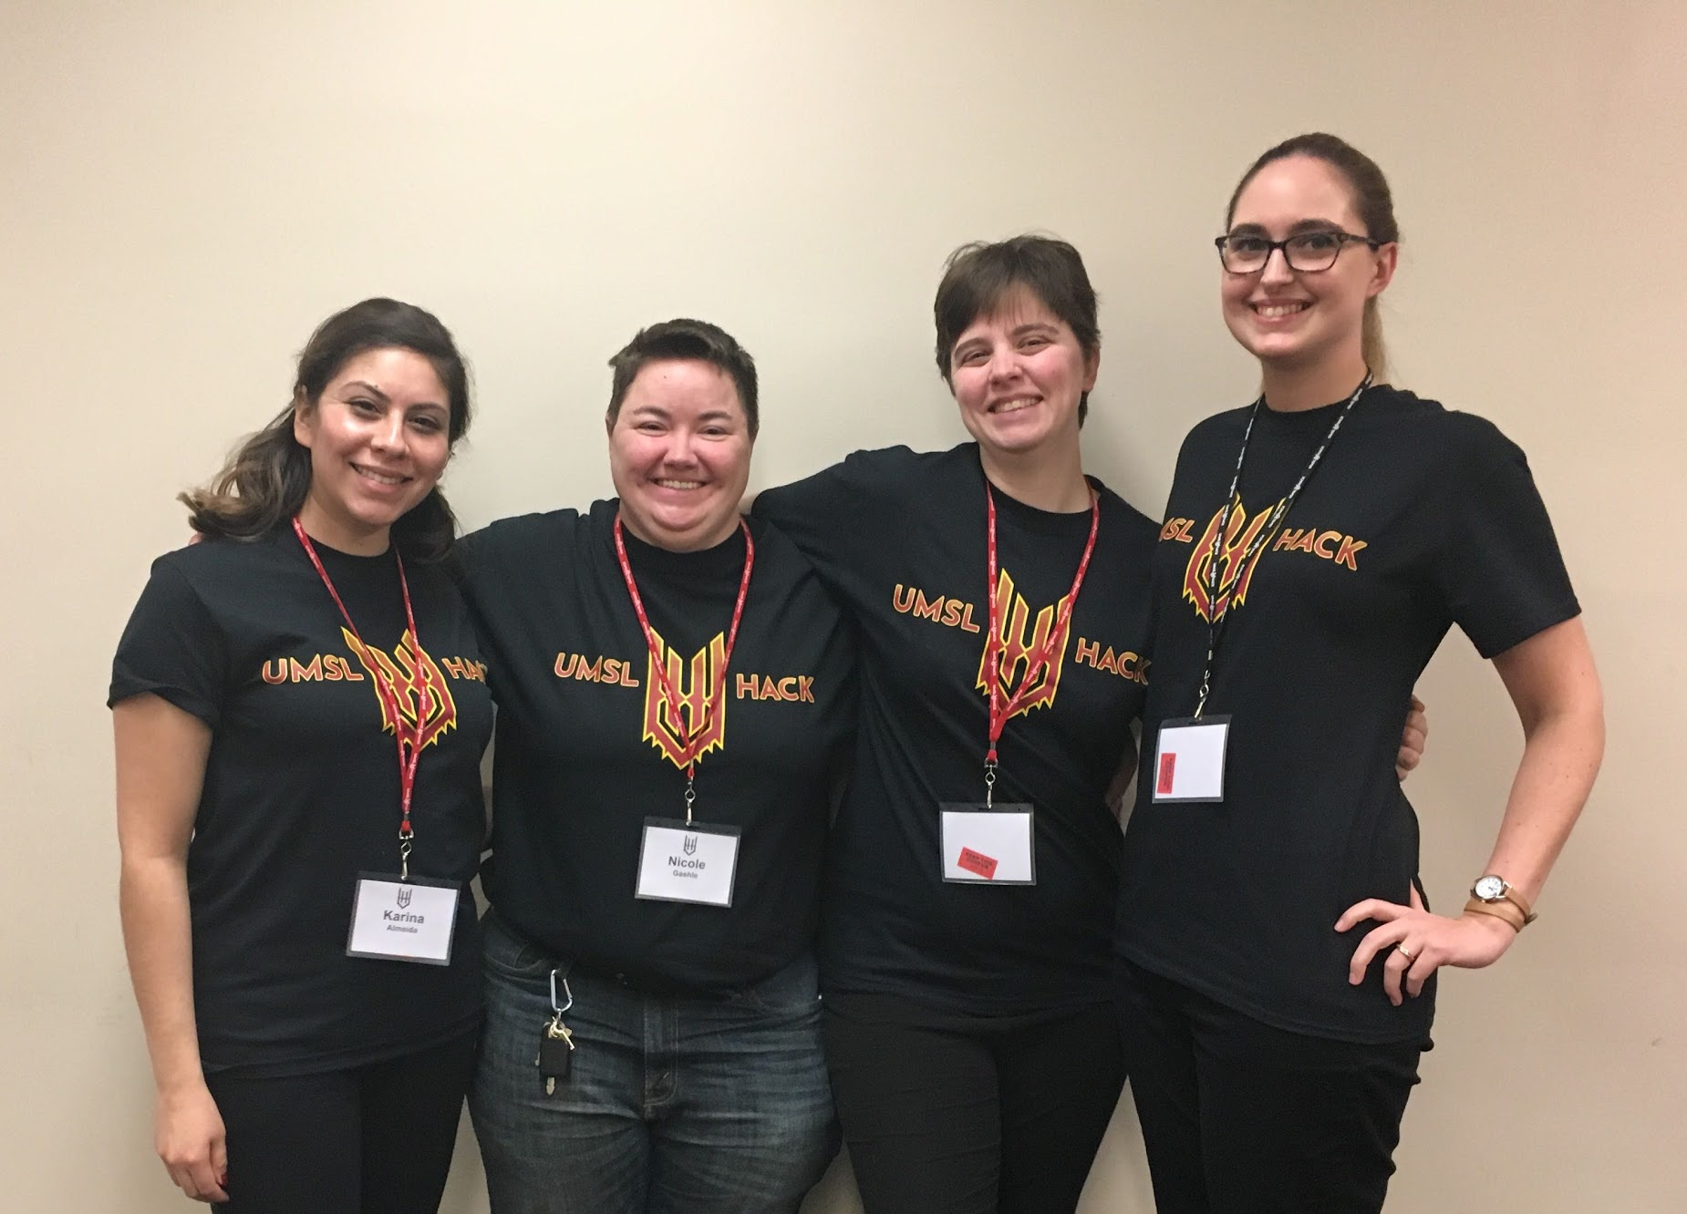
Making Volunteerism Easier
By Team: WOMENHACK
Nicole Gaehle, Jami Howell, Karina Almeida and Emily Koehler
Notes:
Photo credit: Mohamed Langi

Slide 2

As a Volunteer, I want to be able to easily connect with local community organizations and nonprofits.
Notes:
Image source: https://www.qcsd.org/Page/11170

Slide 3

Notes:
Tinder logo belongs to Tinder, we know.

Slide 4
Languages Used
Front: HTML/CSS/JS/VanillaJS
Back:
JSON
DB attempts: noJSON, node.js, java + AWS DynamoDB, Java + CSV files (data “store”)
Languages Used

Slide 5
Demo:
will be done locally
Hosting (Afterwards):
https://ngaehle.github.io/womenhack

Slide 6
Swipe some good.

